Slide 1
Scheduling Application
Introducing

Slide 2
Group Members
Nayma Islam
1
Nushrat Jahan
2
Tawhid Khondakar
3
ID: 18-36607-1
ID: 18-36586-1
ID: 18-36611-1

Slide 3

Wizard!
The app is specially designed to facilitate the user by making them get rid of all the hassles of scheduling routines during pre-registration…

Slide 4
Why app for scheduling..?
The reason can be explained if we first look the problems with scheduling whithout using any system

Slide 5
Problems with scheduling that we regularly face
1. TOO MUCH TIME CONSUMING Thoroughly checking for time clash and thus preparing two or more alternative routine takes lots of effort and time
2. FREQUENT UPDATES Sometimes we may need to change the whole time allocation as well as routine due to the oft updates in timing or sections
3. RISK OF NOT GETTING COURSE Most often the sections we select to take were already allocated and filled with other students
4. NUMEROUS SECTIONS Random times in different sections cause a great confusion among the students during scheduling

Slide 6
Problems with scheduling that we regularly face
5. SWITCHING During the registration period, we may need to switch to a totally different routine with different courses due to not having enough seats
6. LESS INTERACTION There is no interaction medium between students while registering new courses. Thus we cannot divide sections between them to avoid pressure over specific sections
7. RANDOM ACCESS Students are not bound to select in any specific order. So the number students who want to take a specific course may not be the same in all sections.
8. DIFFERENT PRIORITIES While registration some courses are more likely to be choosen and some courses are remaining with a good number of seats

Slide 7
How a system can benefit us..?
Let’s look at the advantages we will get by using a system for scheduling

Slide 8
Advantage of having a system for scheduling
1. TIME EFFICIENCY Where it might took hours to produce two or three handicraft routines, A system can generate more than hundred routines within less than a second
2. EASY SWITCHING We can easily switch to a whole new routine if a section has been filled up with students also we can choose different courses and make new routine very easily within the registration time
3. RELIABILITY As it is so easy to produce a routine and switch between them, the chances of getting courses increases with a great span
4. EASY UPDATES We won’t need to concern with any kind of updates of sections and timing. Using a system can update all the routines within a blink of an eye and show them to the user to be used

Slide 9

SCHEDULING WIZARD

Slide 10
SCHEDULING WIZARD
Anyone can make schedule through this application by simply just registrating an account for themselves
Procudere:
- Create an account.
- Select the courses you want to enroll.
- Click on the generate button to get a branch of prepared routines.
Features:
- Provide the user to iterate over all the courses and get numerous number of routines.
- A search option to easily find any courses.
- A user can edit their profile by changing any information provided on registration.
- An admin account that can manage and store each data from the database.
- Getting all possible combinations to choose the best one.

Slide 11

UI Interfaces

Slide 12
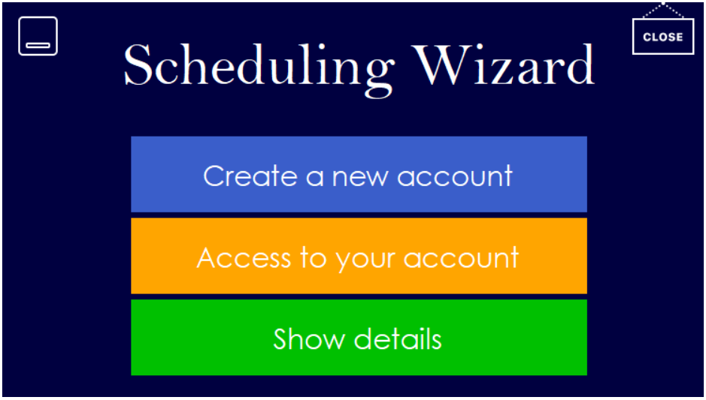
Home Page

Slide 13
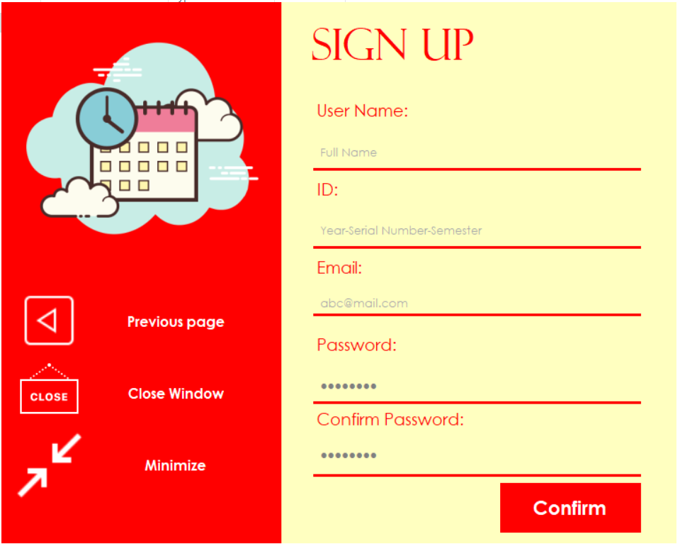
Signup Page
Main page for signing up
Minimizing button
Closing button
Previous page button

Slide 14
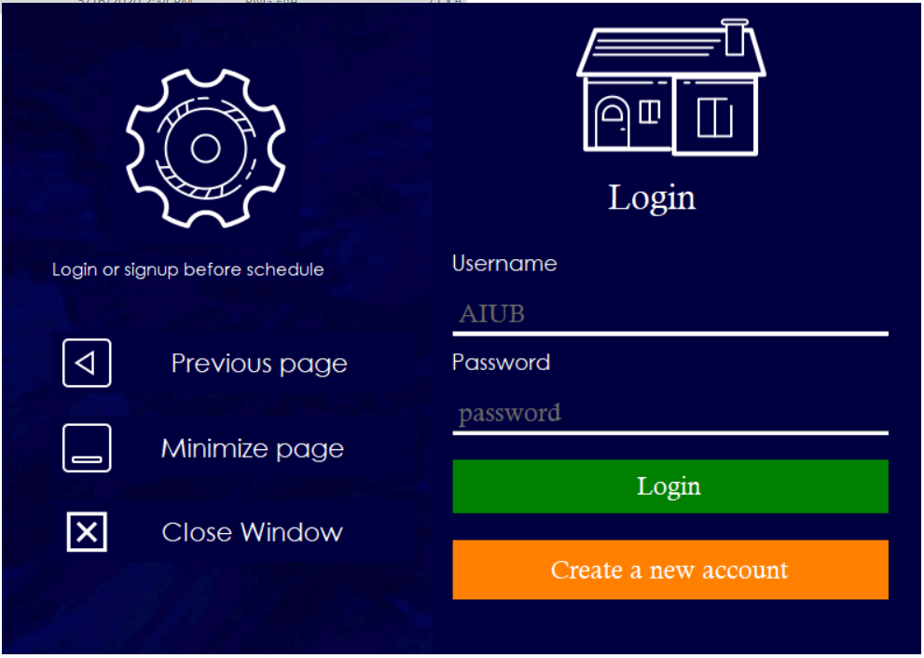
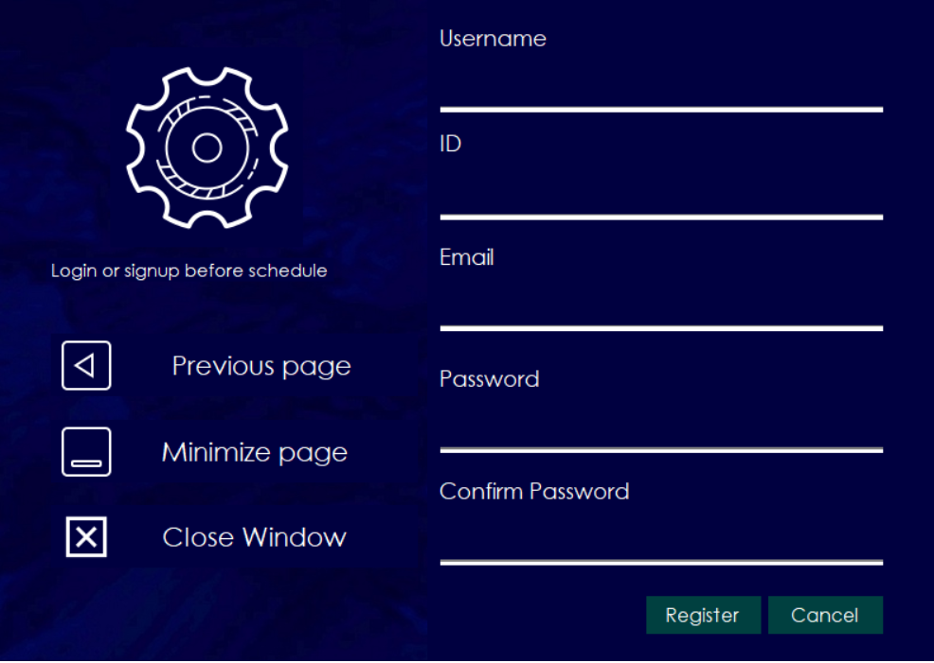
Login Page

Slide 15
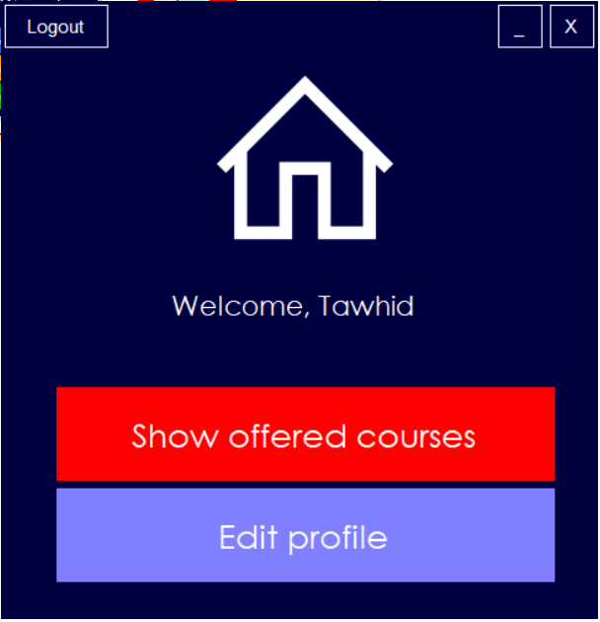
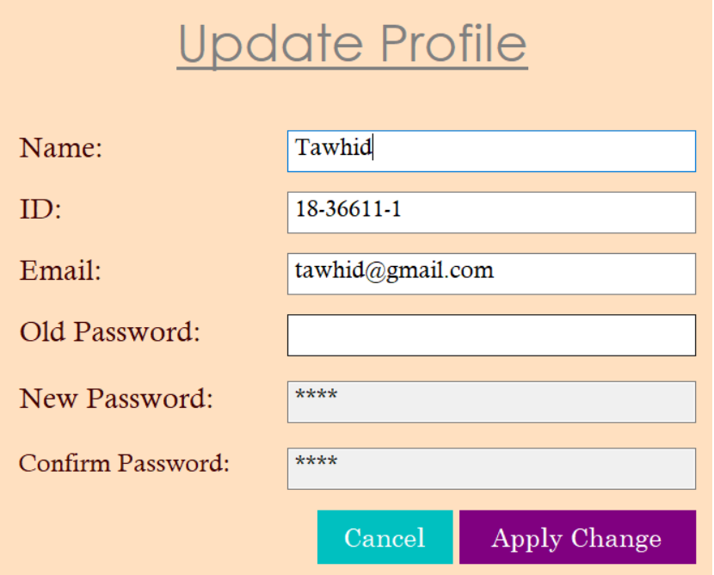
Selection and update page

Slide 16
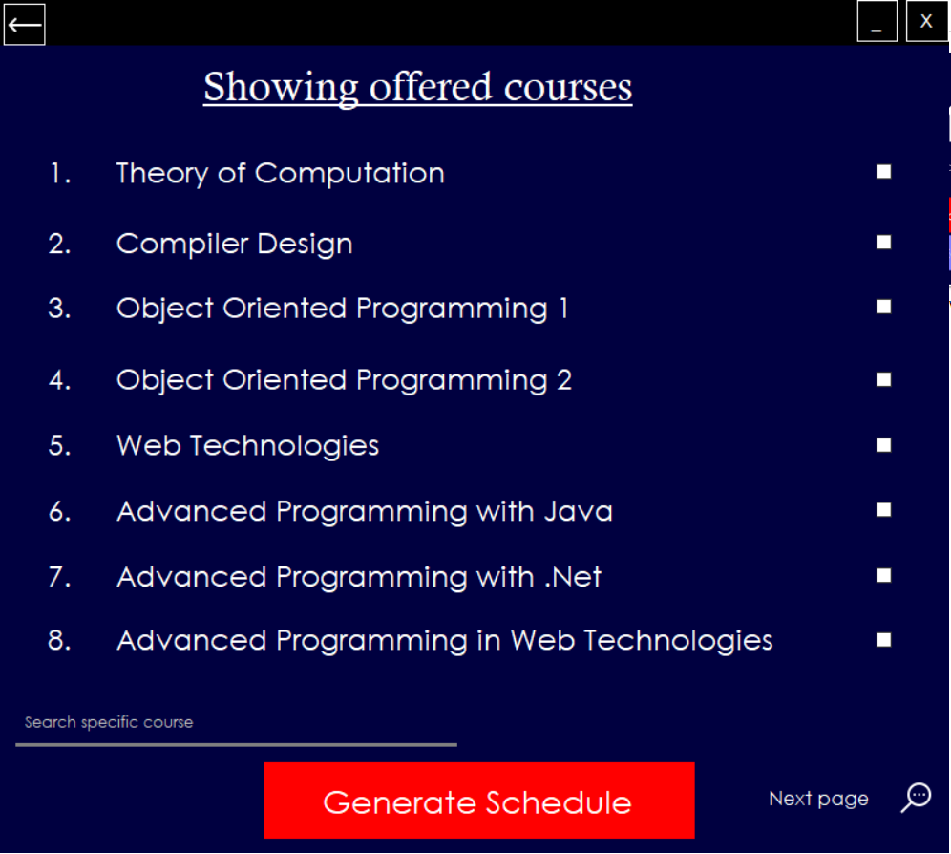
Offered Courses
All courses with individual id
Search Option
Generate Schedule button
Checkbox for selection
Switching to different pages

Slide 17
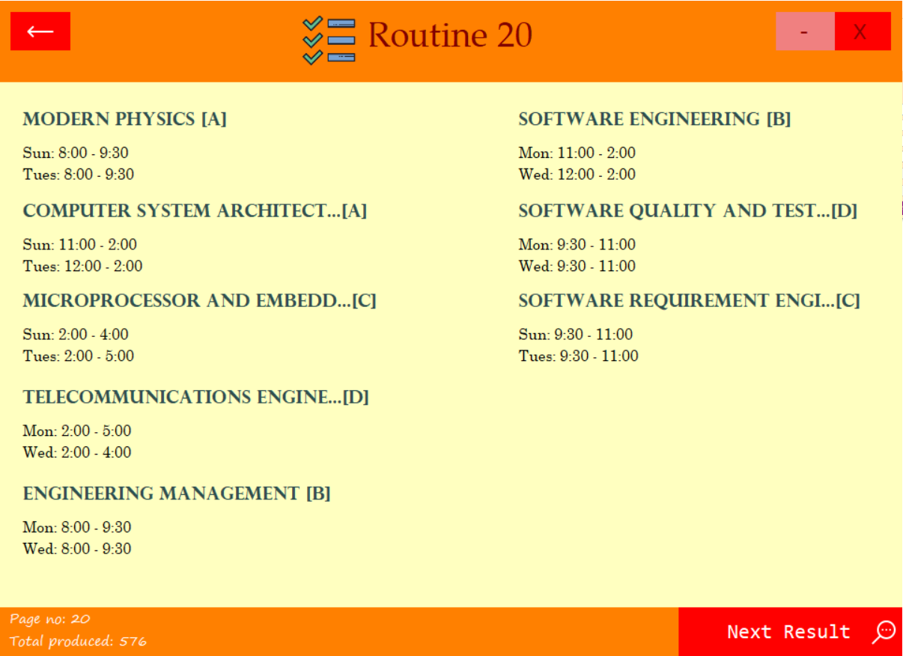
Auto Generated Routine by the System
1. Flexible routines
2. Operation buttons
3. Courses names along
with sections
4. Iterations over different routines
5. Total results

Slide 18
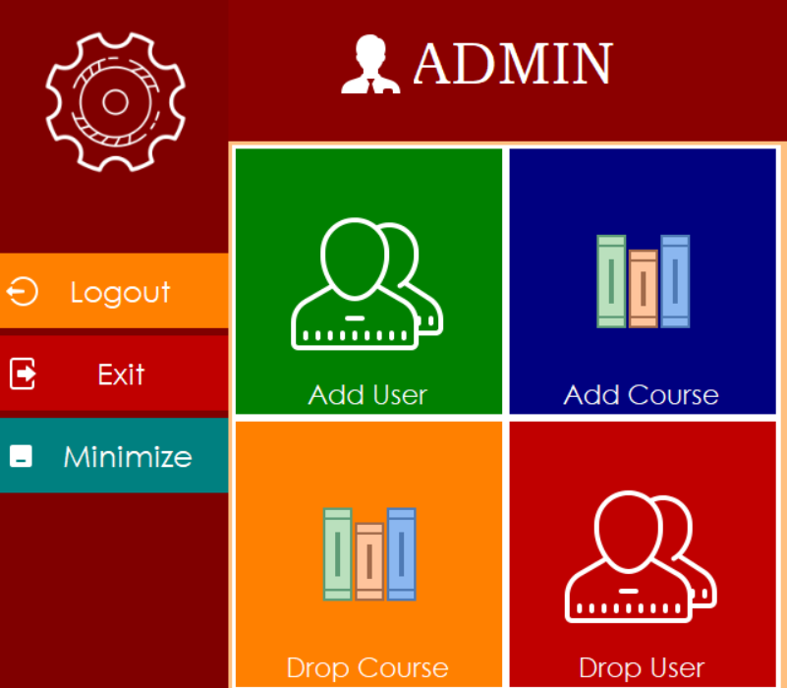
Admin Page
Admin for external
maintenance
Add new courses in the
database
Drop any courses in the
database
Add new user in the
database
Drop existing user from the
database

Slide 19
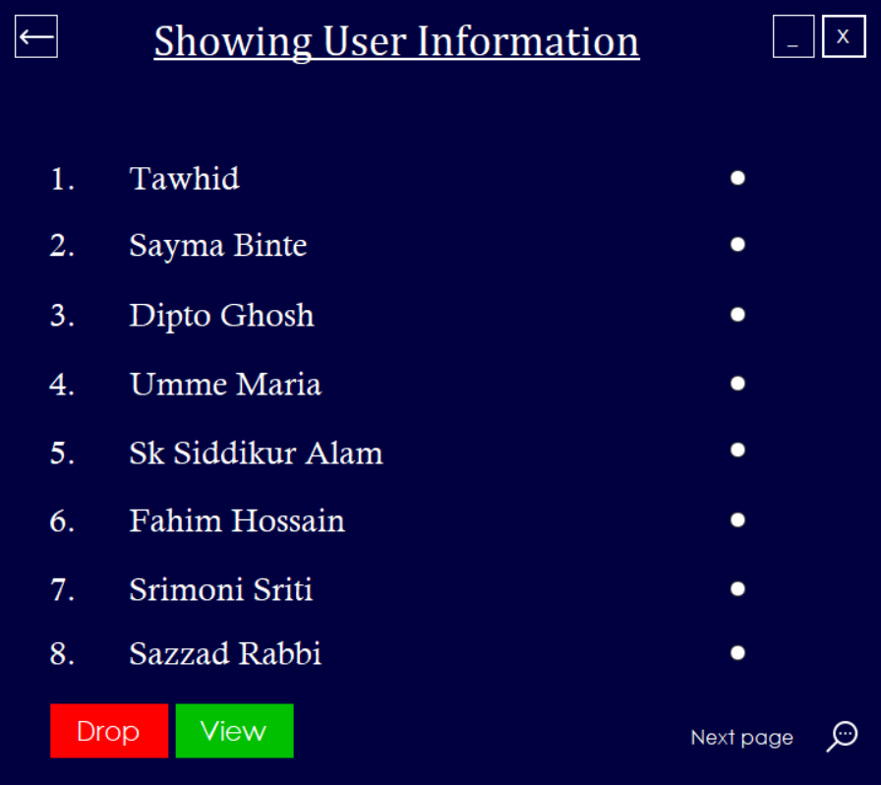
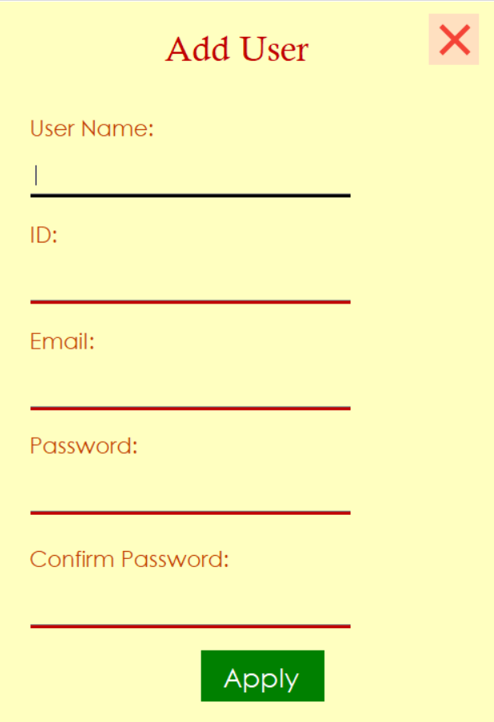
Admin Operation Over User

Slide 20
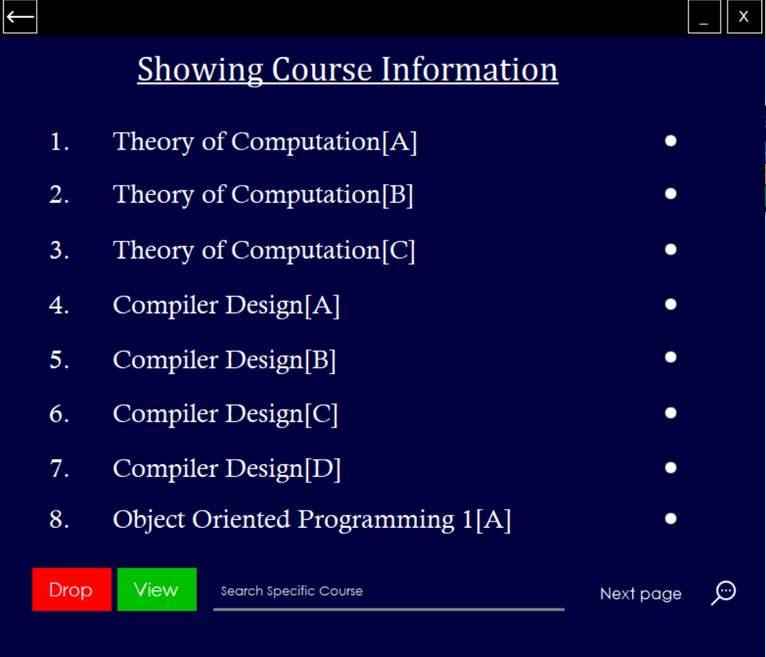
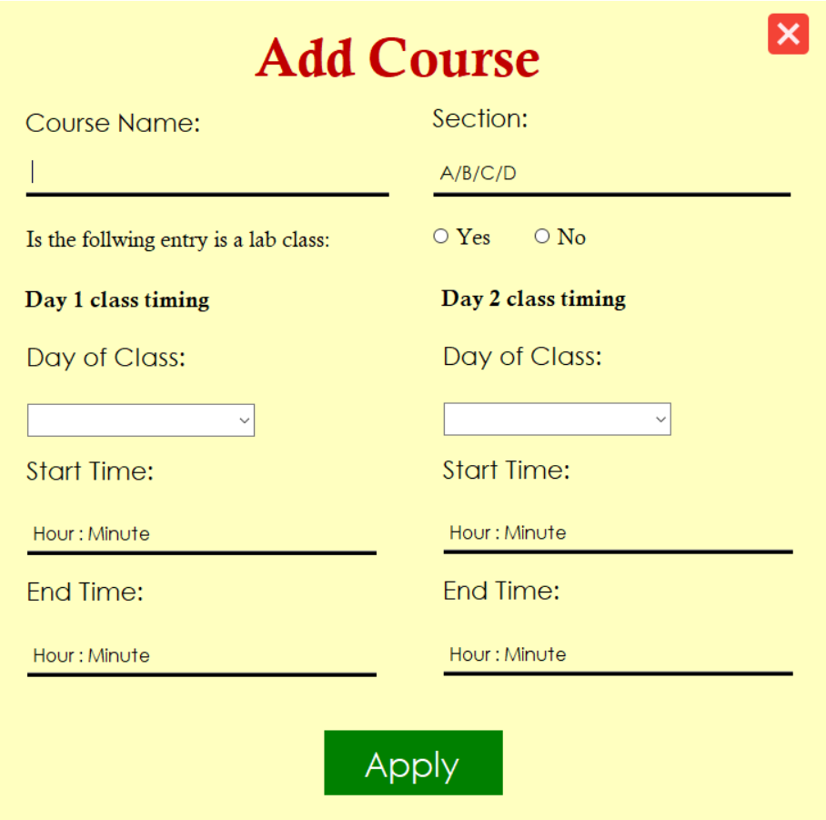
Admin Operation Over Courses

Slide 21
How does it produces random number of routines..?
- The main idea beyond the working principle of this app is a simple recursion.
- Recursion is the simplest way to generate random results and do bigger operations by writing a few lines of codes.

Slide 22
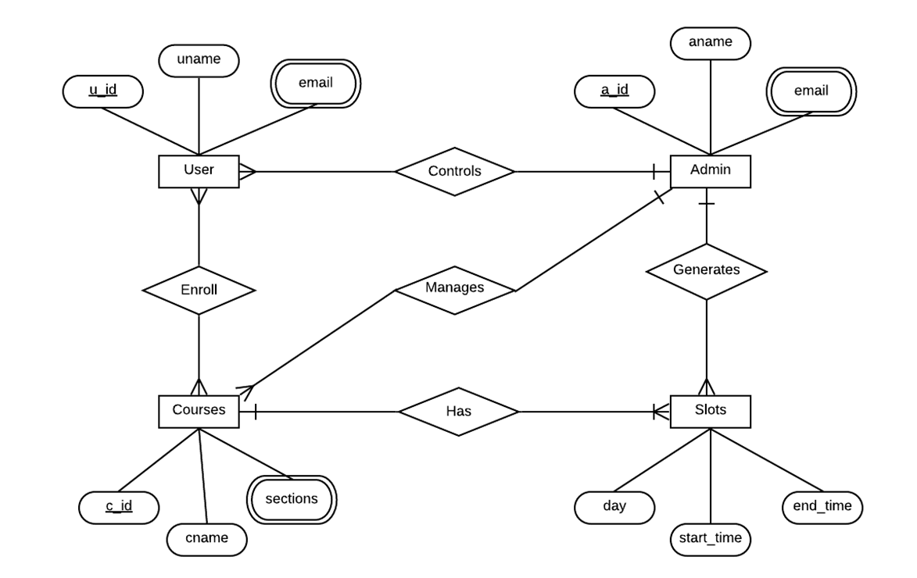
ER Diagram

Slide 23
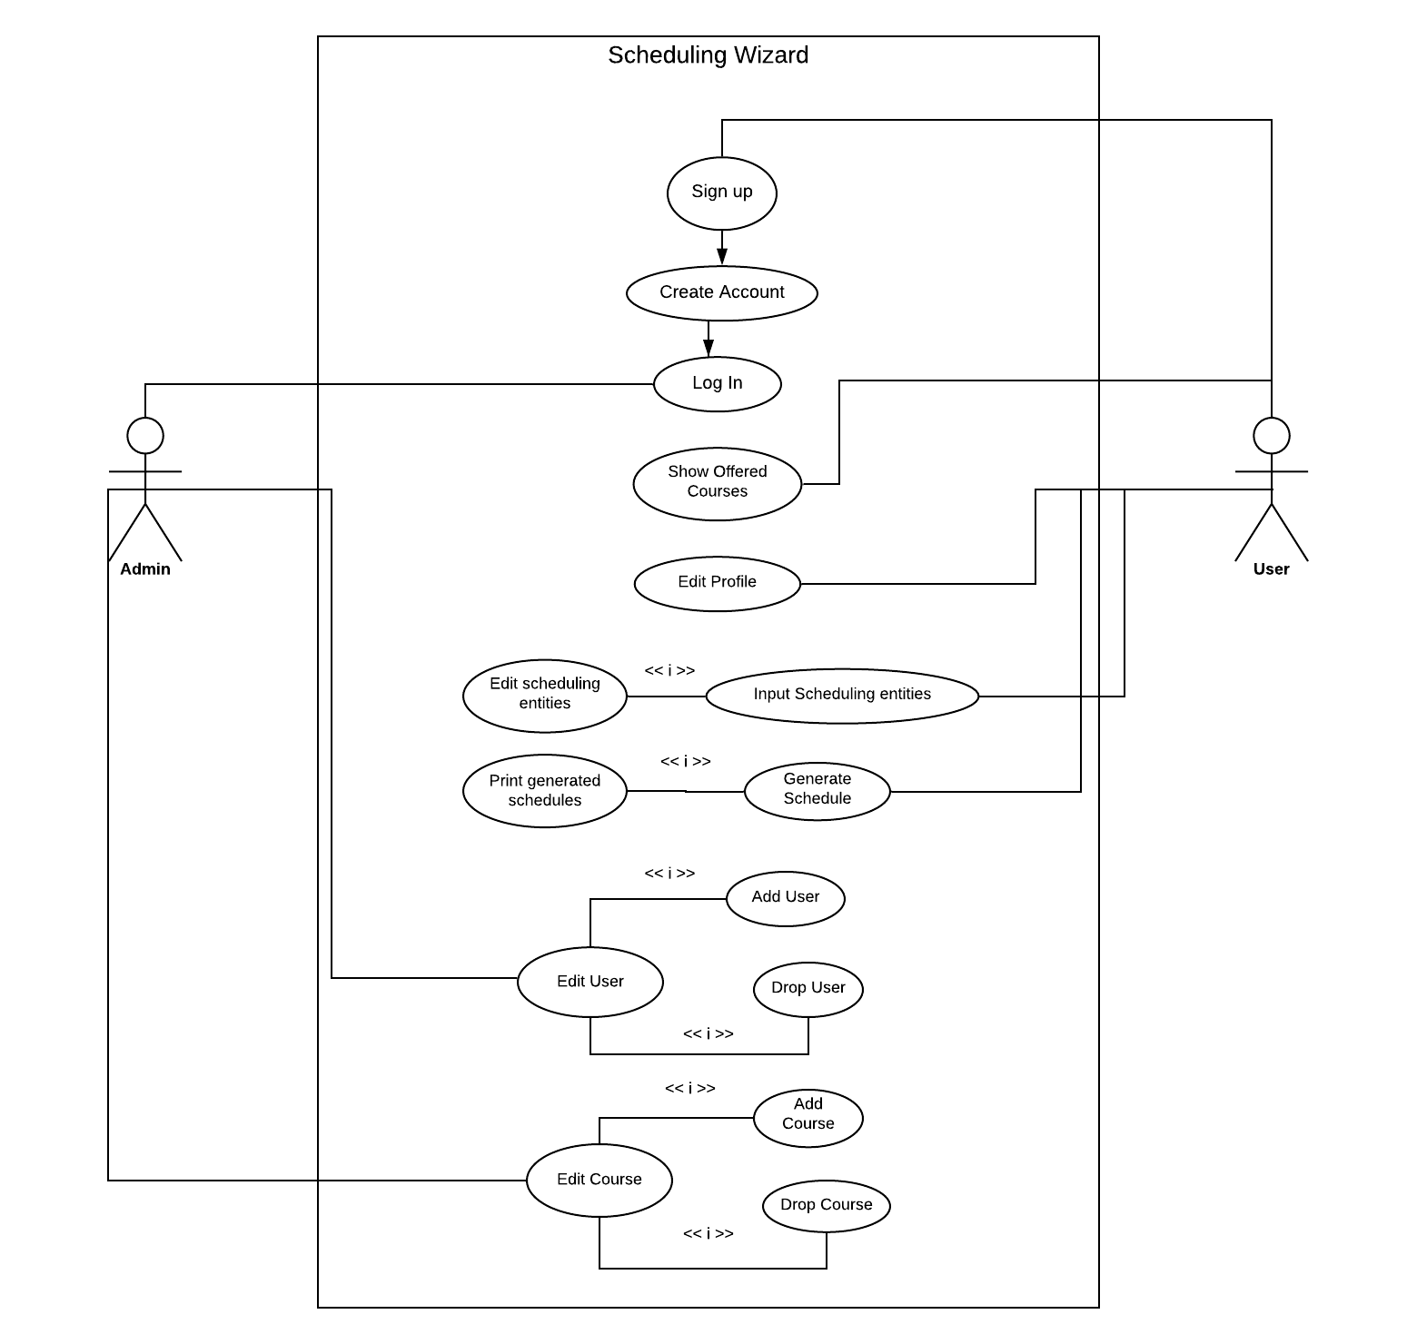
Use Case Diagram

Slide 24

Tables of the

Slide 25
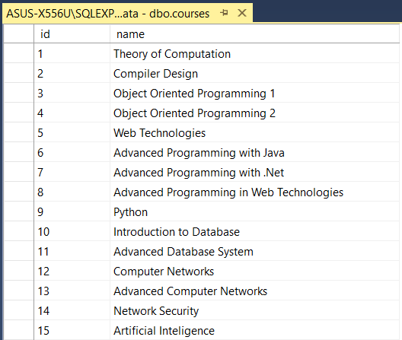
Courses Table

Slide 26
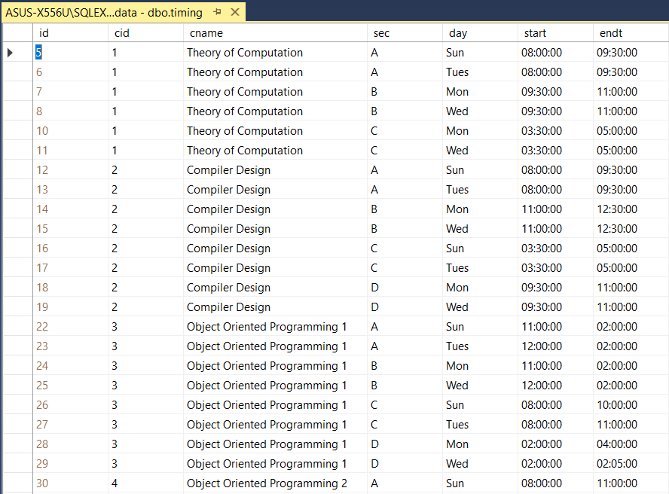
Timing Table

Slide 27
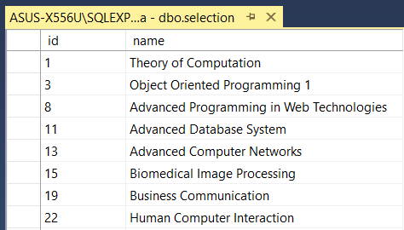
Selection Table

Slide 28
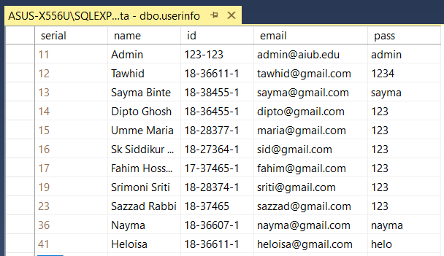
User Information Table

Slide 29
Trick and Tools
To manage and combine the whole data together the following items has been used throughout the app:
- Microsoft sql Server for database management.
- Structures for creating courses and routine datatypes.
- Collections for allocating memory to the random
number of produced results.
- Fundamental c sharp methods and libraries.
- Recursive and boolean methods for checking and creating.

Slide 30
Future Updates
The perfomance of this application can be improved by adding the following items:
- Addling constraints.
- Linking each user profile with their portal.
- Not showing the courses that already has been enrolled.
- Linking the profiles of each user with one another.
- Auto generation of sections for suggession.
- Auto deletion of sections for suggession.

Slide 31


